Slide 1
Chemistry
Branch of science which deals with composition, properties, and use of matter, and laws governing the changes which matter may undergo.

Slide 2
MATTER
Anything which occupies space and posses mass.
States: on basis of arrangement of particles
Gas
Liquid
Solid
Plasma state

Slide 3
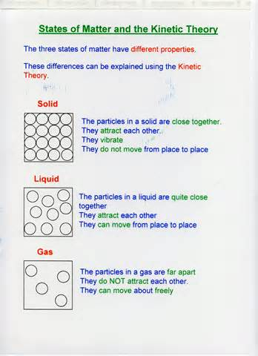

Slide 4
Matter
Matter, the stuff from which our physical world is formed, presents to us as various types of material. On a first analysis, the possible phases are:
gaseous, such as air
liquid, such as water
solid, such as rock
However, for classification purposes it is useful to divide materials into:
mixtures: variable composition
pure substances: constant composition

Slide 5
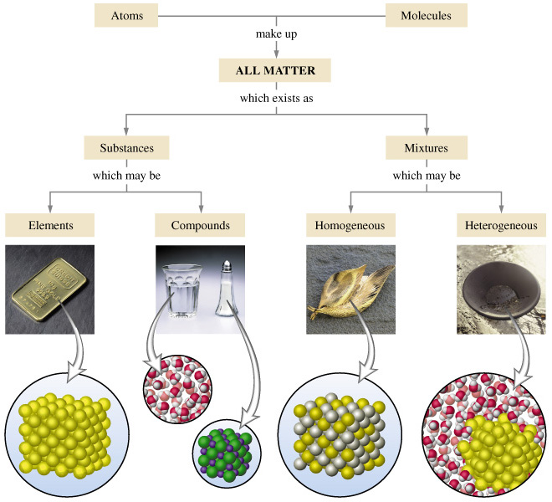

Slide 6
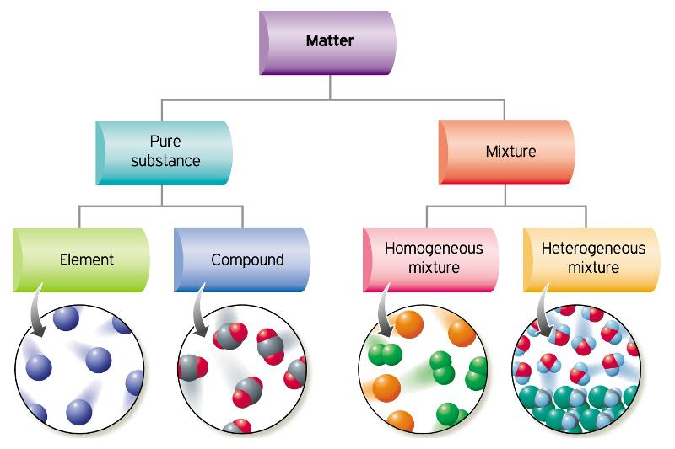

Slide 7
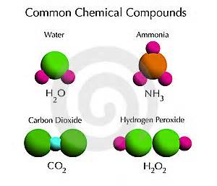

Slide 8
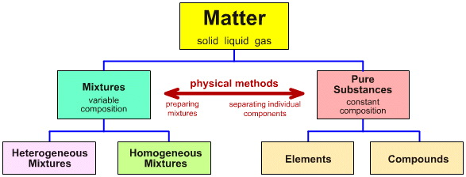

Slide 9
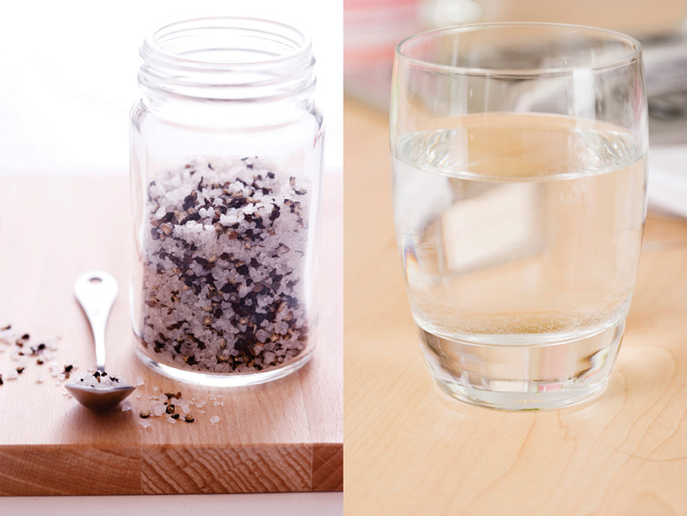

Slide 10
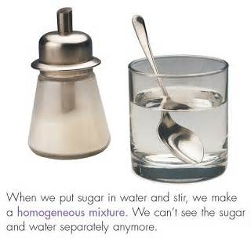

Slide 11
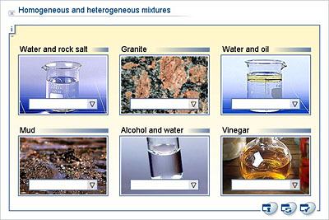

Slide 12
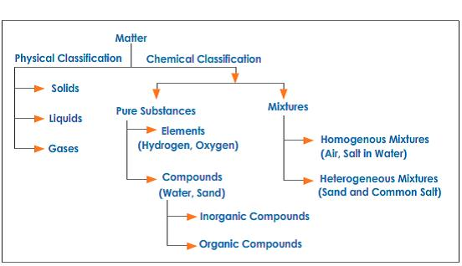

Slide 13
BASIC STRUCTURE OF MATTER
The Atom
All matter such as solids, liquids, and gases, is composed of atoms. Therefore, the atom is considered to be the basic building block of matter. However, atoms are almost always grouped together with other atoms to form what is called a molecule. Only a few gases such as helium are composed of individual atoms as the structural unit.

Slide 14
ELEMENTS
An element defined
Any material that is composed of only one type of atom is called a chemical element, a basic element, or just an element.
Any material that is composed of more than one type of atom is called a compound.
Every element has a unique atomic structure.
109 basic elements
All matter is composed of combinations of one or more of these elements.
Ninety-one of these basic elements occur naturally on or in the Earth.
The other elements are man-made.

Slide 15
ELEMENT
A substance in which all atoms are identical and have same atomic number

Slide 16
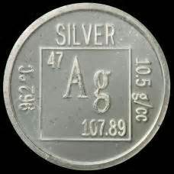
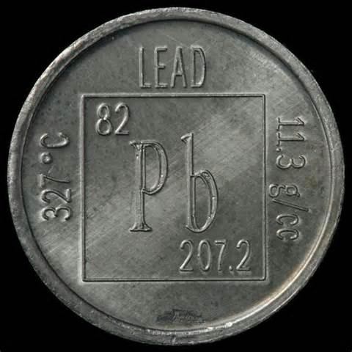
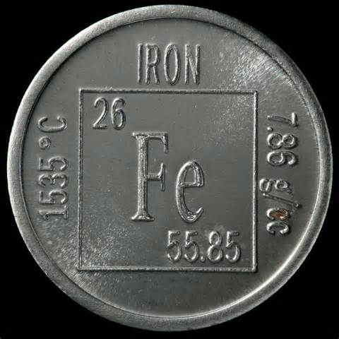

Slide 17
COMPOUND
Substance which consists of two or more elements chemically combined in a fixed proportion by number of atoms

Slide 18
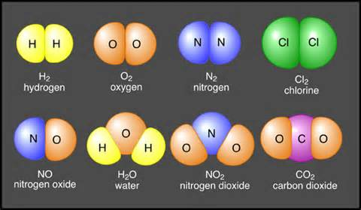

Slide 19
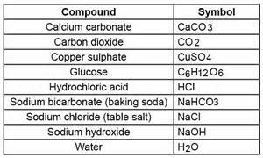

Slide 20
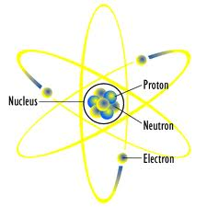

Slide 21
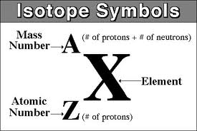
SYMBOL
Abbreviation for chemical name of element and represents one atom
Examples:
Carbon C
Calcium Ca

Slide 22
Formula
Combinations of symbols to represent molecule of compound
Example:
H2O

